Slide 1
FACE DETECTION
VIRAJ JAGALE (4493387)

Slide 2
HISTORY
VIOLA JONES ALGORITHM (2001)
Select Haar features
Create Integral image
Adaboost Training
Cascading classifiers
HISTOGRAM OF ORIENTED GRADIENTS (2005)
Gives gradients for every pixel that direct towards darker side

Slide 3
IMPLEMENTATION
USING TENSORFLOW OBJECT DETECTION API BY GOOGLE
THE API IS TRAINED ON COCO(COMMON OBJECTS IN CONTEXT) DATASET WHICH CONSISTS OF 3000+ IMAGES OF 90 COMMON OBJECTS
API PROVIDES 5 DIFFERENT MODELS THAT PROVIDE TRADE OFF BETWEEN SPEED AND ACCURACY
THESE PRE-TRAINED MODELS CAN BE USED TO TRAIN FOR CUSTOM OBJECT DETECTION
MODEL USED: ssd_mobilenet_v1_coco (fastest).

Slide 4
IMPLEMENTATION
COLLECTING DATA
ANNOTATING IMAGES (REQUIRED IN PASCAL VOC FORMAT)
GENERATE TF RECORDS (SEQUENCE OF BINARY STRING WITH CRC HASH)
CREATE MODEL CONFIG FILE
TRAINING THE MODEL

Slide 5
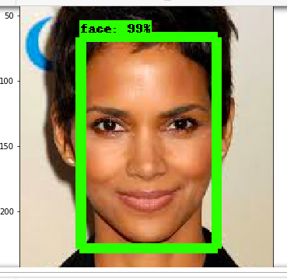
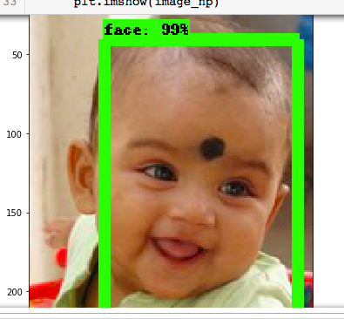
RESULTS

Slide 6
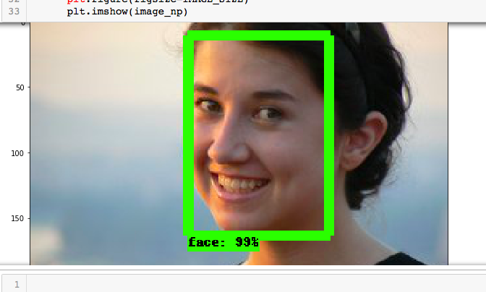
RESULTS

Slide 7
QUESTIONS, SUGGESTIONS

